Slide 1
Crime and Punishment

Slide 2
Crime and Punishment – Fiction (19th Century) By Fyodor Dostoevsky
The Trial –Fiction (20th Century) By Franz Kafka

Slide 3
The Constitution of India is the supreme legal document of the country.
Indian Judiciary is based on typical hybrid legal system known as the Common Law System, in which customs, precedents and legislative are all components of the law.
The Indian judiciary is independent of the executive and legislative branches of government according to the Constitution.

Slide 4
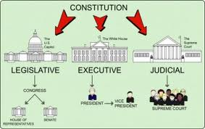

Slide 5
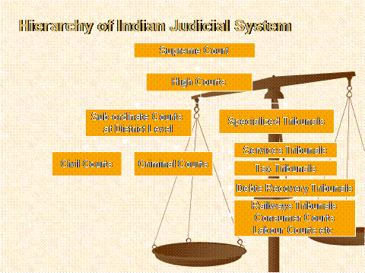

Slide 6
Issues
Court personnel are paid off to slow down or speed up a trial, or to make a complaint go away.
Judges are also subject to pressure from above, with legislators or the executive using their power to influence the judiciary, starting with skewed appointment processes.
Citizens are often unaware of their rights, or resigned, after so many negative experiences, to their fate before a corrupt court.
Court efficiency is also crucial, as a serious backlog of cases creates opportunities for demanding unscheduled payments to fast-track a case.

Slide 7
Backlogs in Indian Courts
Delhi High Court -466 years according to its chief justice.
Average processing time - 4 minutes and 55 seconds.
Backlogs Vs Pendency
the case of Mohammed Idrees
People's faith in judiciary decreasing at an alarming rate

Slide 8
Problems of Judiciary
Large number of vacancies in trial courts,
Unwillingness of lawyers to become judges
Failure of the apex judiciary in filling vacant HC judges posts.
Judicial corruption

Slide 9
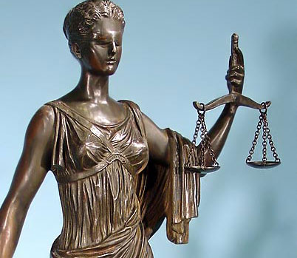
Turning a blind eye to the injudicious conduct of a colleague Hypocrisy – the complete distortion of the norm of judicial independence Secrecy – the fact that no aspect of judicial conduct including the appointment of judges to the High and Supreme Court is transparent Plagiarism and prolixity – meaning that very often SC judges lift whole passages from earlier decisions by their predecessors and do not acknowledge this – and use long-winded, verbose language Self Arrogance – wherein the higher judiciary has claimed crass superiority and independence to mask their own indiscipline and transgression of norms and procedures Professional arrogance – whereby judges do not do their homework and arrive at decisions of grave importance ignoring precedent or judicial principle Nepotism – wherein favors are sought and dispensed by some judges for gratification of varying manner.
Seven Sins of Judiciary

Slide 10
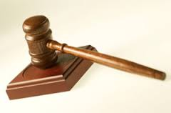
Right to be Considered Innocent until Proven Guilty presumption of innocence and the right to a defence non-retroactivity of law
Judicial Rights

Slide 11
Justice Delayed is Justice Denied
inefficiency and delay will drain even a just judgment of its value;
Poverty can be ground for commuting death

Slide 12
Politics and Crime
According to a report out of the 4,835 MPs and MLAs in the country, 1,448 are facing criminal cases.
Out of these 1448 members who have declared criminal cases, 641 have declared serious criminal cases like rape, murder, attempt to murder, kidnapping, robbery, extortion etc.

Slide 13
Reforms
E-Courts Mission Mode Project
Judicial Service Centre
Persons in lawful custody cannot contest poll: Supreme Court
India’s new Anti-rape Bill

Slide 14
E-Courts Mission Mode Project
Established in 2005, By 2010 all district courts were computerized. In 2011, work initiated in supreme court.
The project also includes producing witnesses through video conferencing
The IT department has one system officer and two system assistants in each court.
http://lobis.nic.in http://judis.nic.in

Slide 15
Judicial Service Centre
The Public as well as the advocates can walk in directly and ask for the case status, stage and next hearing dates.

Slide 16
India’s new Anti-rape Bill
1. punishment for police officers who fail to record the initial complaint
2. creates a separate offense to address acid attacks
3. making “sexually colored” remarks
1. Such officers can receive jail terms of six months to two years
2. prison sentences ranging from 10 years to life and a fine
3. prison sentence of up to a year.

Slide 17
4. The bill criminalizes the forced stripping of women, or disrobing, in public spaces or in private confines
5. Voyeurism
Stalking
When a rape leaves a woman dead or in a “persistent vegetative state,”
4. minimum jail term of three years and a maximum of seven
5. three to seven years in prison
6. sentenced to a term of up to three years
7. Twenty years in prison and a maximum punishment of death

Slide 18
International Law
The term "international law" refer to three distinct legal disciplines:
Public international law - which governs the relationship between states and international entities. It includes these legal fields:
treaty law
law of sea
international criminal law
laws of war or international humanitarian law
international human rights law.
Private international law or conflict of laws, which addresses the questions of
(1) which jurisdiction may hear a case, and
(2) the law concerning which jurisdiction applies to the issues in the case.
Supranational law or the law of supranational organizations, which concerns regional agreements where the laws of nation states may be held inapplicable when conflicting with a supranational legal system when that nation has a treaty obligation to a supranational collective.
Source: http://en.wikipedia.org/wiki/International_law

Slide 19
TADA Court
Sanjay Dutt
Abu Salem

Slide 20
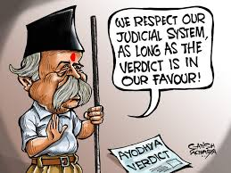

Slide 21
Do you think Poverty, Socio-economic, Psychic compulsions, undeserved adversities in life need to be considered while sentencing corporal punishment to the guilty ?

Slide 22
Acknowledgement: Bulk of the slides are from the pdf. file Crime and Punishment. For source material see the links provided in that file.

